Slide 1
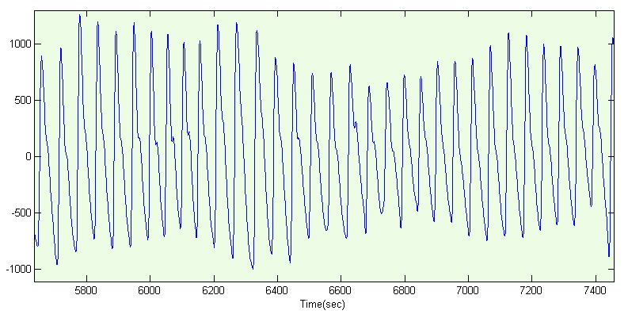
Cardiovascular System Analysis Based on PPG Signal
Biological Signal Project
3 June 2014
Alex Bazko
Aditya Iman Rizqy

Slide 2
What is PPG (Photopletysmography) ?
PPG is optical measurement that detects blood volume changes in the microvascular bed of tissue
A photodetector is placed on a tissue’s surface alongside the LED and records the reflected light
Light is attenuated by oxygenated and deoxygenated hemoglobins, and other components in muscle and skin.
Reductions in light intensity = relative increases in blood volume and vice versa

Slide 3
Task :
In the GUI (Graphical User Interface) :
Importing the raw signal from a Biopac text export
Entering a sampling frequency
Displaying plots of the raw signal
Displaying Peak to Peak, Pulse Height (within a chosen time interval).
Computing Mean Arterial Pressure and Heart Rate Variability

Slide 4
GUI Demonstration . .

